Slide 1
フラーレン超伝導体の電子格子相互作用を含む低エネルギー模型導出
Ab initio derivation of low-energy model including phonon terms
for C₆₀ superconductors
野村悠祐、^{A}中村和磨、有田亮太郎
東大工、^{A}九工大院
YN-Nakamura-Arita, Phys. Rev. B 85, 155452 (2012)
YN, K. Nakamura, and R. Arita, Phys. Rev. Lett. 112, 027002 (2014)
See also P29
改良された連続時間量子モンテカルロ法による
多軌道クラスター動的平均場理論
YN, S. Sakai, and R. Arita, arXiv: 1401.7488

Slide 2
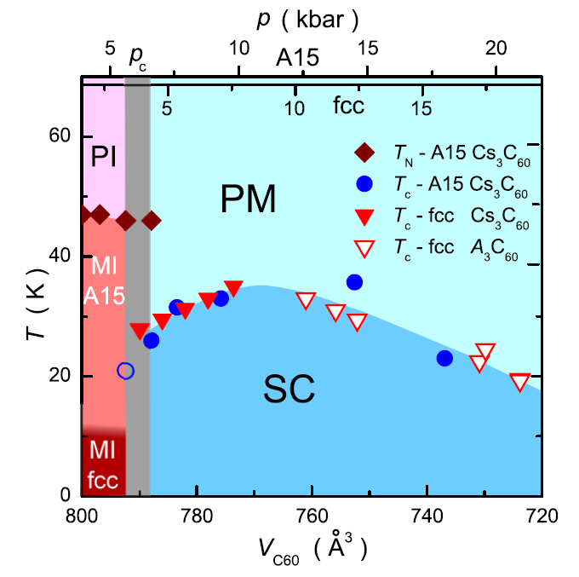
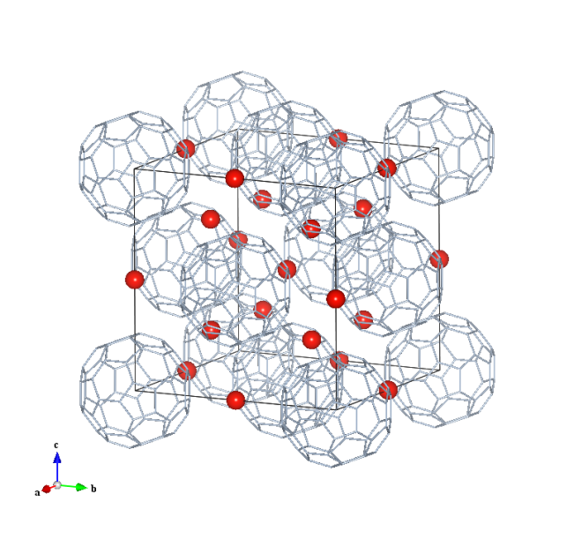
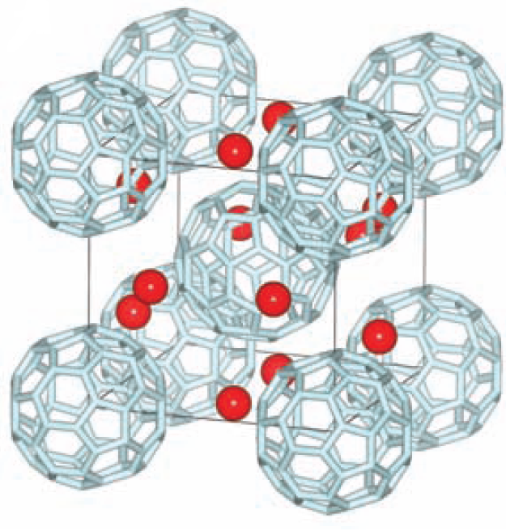
C₆₀ superconductors
fcc system
K₃C₆₀ : Tc=19K
Rb₃C₆₀ : Tc=29K
Cs₃C₆₀ : Tc=35K
Phase diagram
A15 system
Cs₃C₆₀ : Tc = 38K
O.Gunnarsson Rev.Mod.Phys. 69, 575 (1997)
Ganin et al, Nature 466,221(2010)
A.Ganin et al Nature Mater. 7,367-371(2008)
Y.Takabayashi et al Science 323,1285-1590(2009)
Y. Ihara et al., EPL 94, 37007 (2011)
narrow band (molecular orbital + small hopping)
3band half-filling (LUMO)
Cs₃C₆₀ at ambient pressure: low-spin insulator (S=1/2)
Tc as a function of pressure shows dome-like behavior

Slide 3
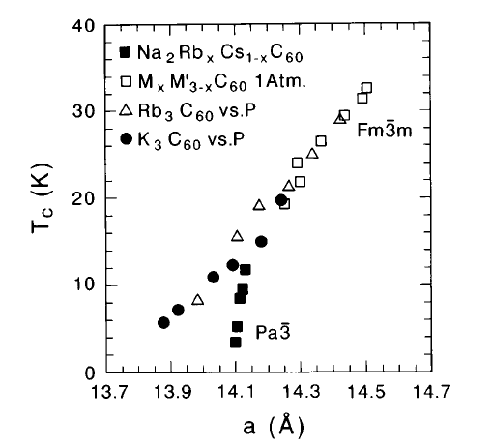
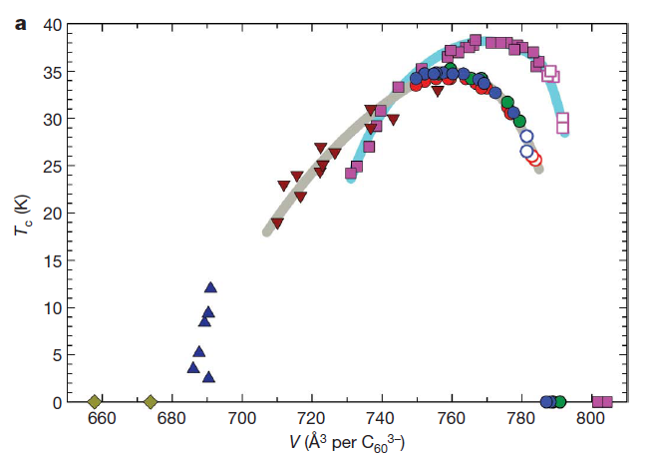
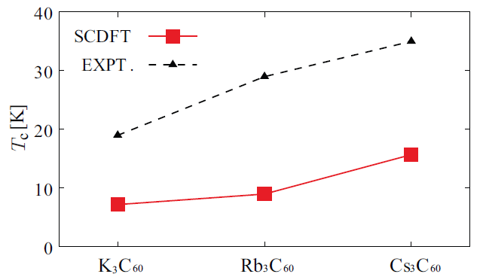
Superconductivity in C₆₀ compounds
lattice parameter a
O.Gunnarsson Rev.Mod.Phys. 69, 575 (1997)
transfer integral t
old study
band width W
can be explained within the BCS theory
density of states N(E_{F})
T_{C}
cf.
ω_{D}~1000K
fcc
A15
recent study
Ganin et al, Nature 466,221(2010)
R. Akashi and R. Arita, PRB 88, 054510 (2013)
can not be explained within Migdal-Eliashberg theory

Slide 4
Motivation
Q. What is the mechanism of superconductivity?
Q. Origin of low-spin state?
Q. Unified description of the phase diagram?

Slide 5
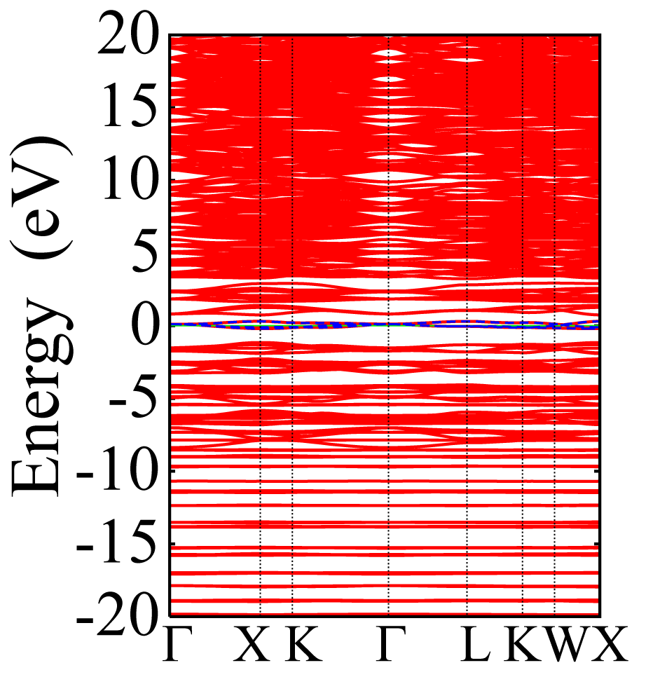
Effective low-energy model
Ab initio Hamiltonian
Effective Hamiltonian
global energy scale
low energy scale
trace out
Virtual (V)
E_{F}
renormalize
Target (T)
Target (T)
Occupied (O)
trace out

Slide 6
Ab initio downfolding for electron-phonon coupled systems
Low-energy models for electron-phonon coupled systems:
i,j: orbital (Wannier) indices (w): Wannier gauge σ : spin index
O^{(p)}: the quantity with constraint (partially screened)
Q. How do we evaluate one-body part ?
A. Maximally localized Wannier function (maxloc)
N. Marzari and D. Vanderbilt, Phys. Rev. B. 56 12847 (1997)
I. Souza et al., ibid. 65, 035109 (2001)

Slide 7
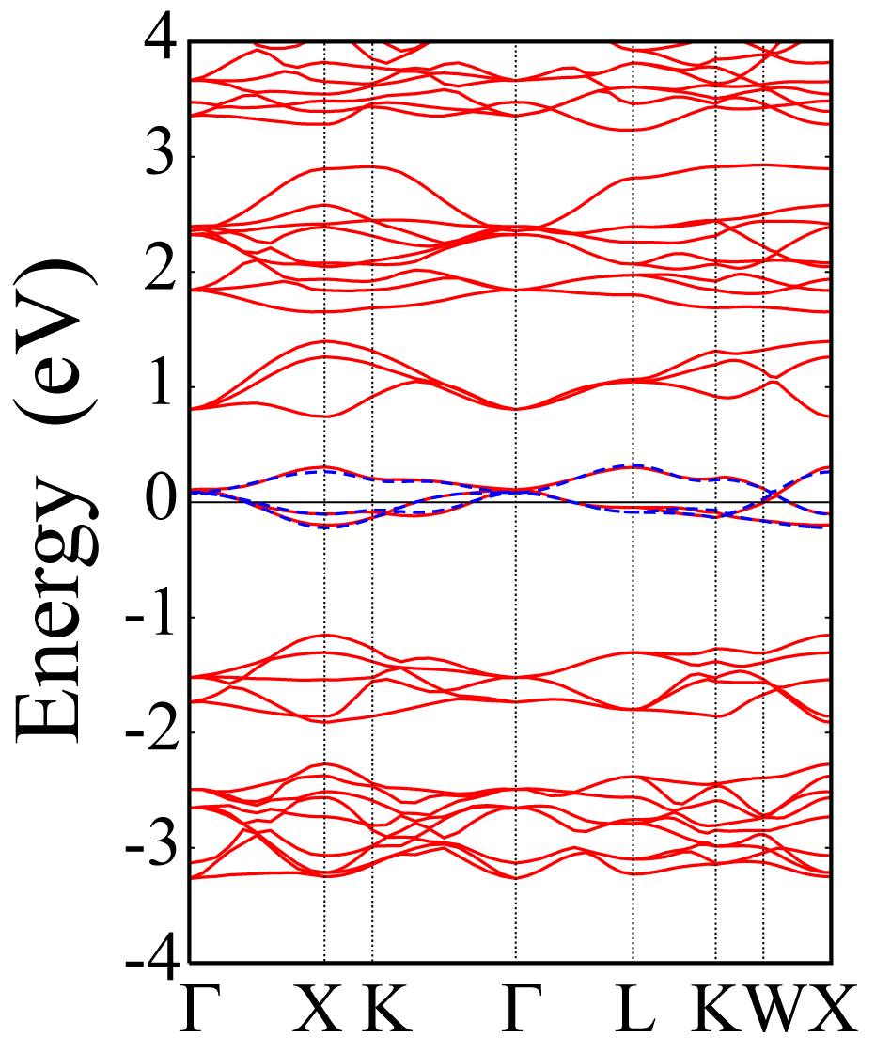
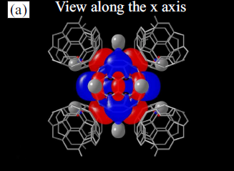
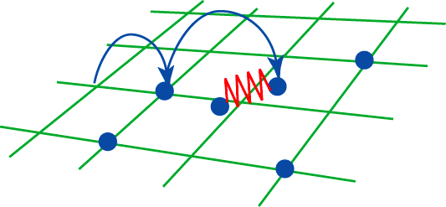
One body part of the Hamiltonian
Band structure of fcc K₃C₆₀
Max loc Wannier
Virtual (V)
t_{1u} band
W=0.51eV
Target (T)
Occupied (O)
YN-Nakamura-Arita, Phys. Rev. B 85, 155452 (2012)
Hopping between molecular orbital

Slide 8
Ab initio downfolding for electron-phonon coupled systems
Low-energy models for electron-phonon coupled systems:
i,j: orbital (Wannier) indices (w): Wannier gauge σ : spin index
O^{(p)}: the quantity with constraint (partially screened)
Q. How do we evaluate ?
A. Constrained random phase approximation (cRPA)
F. Aryasetiawan et al., Phys. Rev. B. 70 19514 (2004)

Slide 9
Constrained RPA
F. Aryasetiawan et al., Phys. Rev. B. 70 19514 (2004)
・Independent particle polarizability(RPA)
V
②
③
①
②
③
④
①
E_{F}
＝①＋②＋③＋④
exclude the contribution from
T↔T scattering
This screening process should be considered when we solve the low-energy effective model
④
T
Occupied (O)
V:virtual
T:target

Slide 10
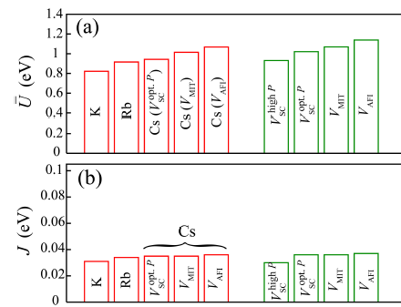
cRPA result for C₆₀ superconductors
YN-Nakamura-Arita, Phys. Rev. B 85, 155452 (2012)
fcc A₃C₆₀
A15 Cs₃C₆₀
U～1eV, J～0.035eV

Slide 11
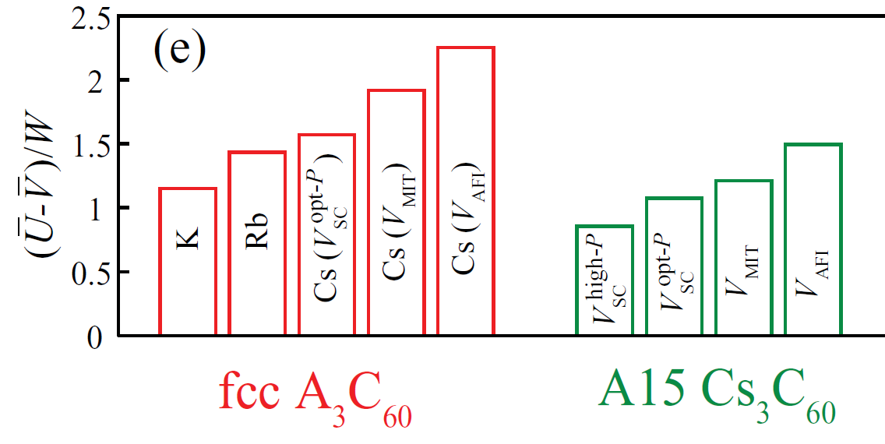
cRPA result for C₆₀ superconductors
YN-Nakamura-Arita, Phys. Rev. B 85, 155452 (2012)
Correlation strength (U-V)/W
U～1eV, J～0.035eV, V～0.3eV, and W～0.5eV
Strongly correlated system

Slide 12
Ab initio downfolding for electron-phonon coupled systems
Low-energy models for electron-phonon coupled systems:
i,j: orbital (Wannier) indices (w): Wannier gauge σ : spin index
O^{(p)}: the quantity with constraint (partially screened)
Q. How do we evaluate and ?
A. Constrained density-functional perturbation theory (cDFPT)
YN, K. Nakamura, and R. Arita, Phys. Rev. Lett. 112, 027002 (2014)
cf. Density-functional perturbation theory (without constraint)
S. Baroni et al, Rev. Mod. Phys. 73, 515 (2001).

Slide 13
Phonon frequency and electron-phonon coupling
S. Baroni et al, Rev. Mod. Phys. 73, 515 (2001).
Phonon frequencies and electron-phonon couplings are given by
(for simplicity we consider the case where there is one atom with mass M in the unit cell)
ν：phonon mode
u : displacement of the ion
Dynamical matrix
: characteristic
length scale
Potential change due to the ionic displacement
where
E : electron ground-state energy
α: cartesian coordinates (x,y,z)
n(r): electron density
Interatomic force constant
(~spring constant)
renormalizing (softening)
bare
bare
Hartree + exchange correlation terms (screening)

Slide 14
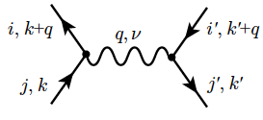
Constrained density-functional perturbation theory
YN, K. Nakamura, and R. Arita, Phys. Rev. Lett. 112, 027002 (2014)
In the metallic case, is given by
n,m: band indices
V
②
Exclude target-target processes
①
③
E_{F}
①
②
③
④
④
T
Occupied (O)
Partially screened quantities such as and
(excluding the target-subspace renormalization effect)
V:virtual
T:target
Effective on-site el-el interactions coming from the exchange of phonons:
momentum-space average -> on-site quantity

Slide 15
cDFPT results for fcc A₃C₆₀
Lattice constant
small
large
 | K₃C₆₀ | Rb₃C₆₀ | Cs₃C₆₀ | Cs₃C₆₀ | Cs₃C₆₀
U_{ph} (0) [eV] | -0.15 | -0.14 | -0.11 | -0.12 | -0.13
U’_{ph} (0) [eV] | -0.053 | -0.042 | -0.013 | -0.022 | -0.031
J_{ph} (0) [eV] | -0.050 | -0.051 | -0.051 | -0.051 | -0.052
U_{ph} = V_{ii,ii ,} U’_{ph} = V_{ii,jj ,} J_{ph} = V_{ij,ij}
|J_{ph} (0) | ~ 0.05 eV > J_{H} ~ 0.035 eV
(Inverted Hund’s rule)
U’_{ph} ~ U_{ph} – 2J_{ph}
Frequency dependent interaction
frequency dependence
U_{ph}
ω_{D} ~ 0.1-0.2 eV
ω_{l}
-0.15

Slide 16
Conclusion
developed an ab initio downfolding method for el-ph coupled systems
- applicable also to multi-ferroic materials, thermoelectric material, dielectrics,
polaron problem, …
Results for C₆₀ superconductors
Effective Coulomb interaction parameters
U ~ 1 eV, J ~ 0.035 eV → strongly correlated systems
Effective phonon mediated interaction parameters:
U_{ph}(0) ~ -0.1 eV, J_{ph}(0) ~ -0.05 eV
Inverted Hund’s rule is realized
YN, K. Nakamura, and R. Arita, Phys. Rev. Lett. 112, 027002 (2014)
YN-Nakamura-Arita, Phys. Rev. B 85, 155452 (2012)

Slide 18
P29
改良された連続時間量子モンテカルロ法による
多軌道クラスター動的平均場理論
Multi-orbital cluster dynamical mean-field theory
with an improved continuous-time quantum Monte Carlo algorithm
野村悠祐、酒井志朗、有田亮太郎
東大工

Slide 19
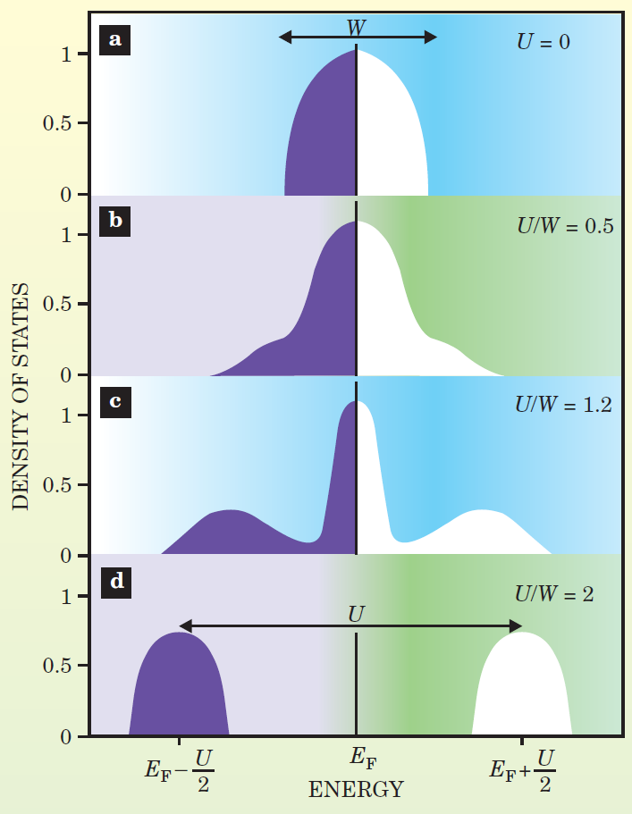
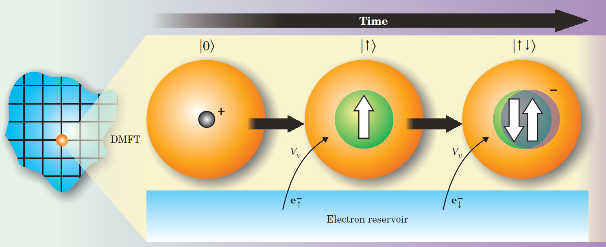
Dynamical Mean-Field Theory (DMFT)
map
Lattice model single-impurity Anderson model
+ self-consistency
◎local dynamical quantum correlation
◎can treat el-el and el-ph interaction on same footing
× spatial correlation
Quasi- particles
Lower
Hubbard band
Upper
Hubbard band
G. Kotliar and D. Vollhardt, Physics Today, 3, 53 (2004).

Slide 20
DMFT with quantum Monte Carlo
E. Gull et al., Rev. Mod. Phys. 83, 349 (2011)
CT-INT -weak coupling expansion (diagrammatic approach)
◎cluster expansion
◎can treat various types of interaction (Hund’s coupling, el-ph interaction)
× low temperature
CT-AUX -weak coupling expansion (auxiliary-field decomposition)
◎cluster expansion
◎efficient update scheme (submatrix update)
× low-temperature
× various types of interaction
CT-HYB -strong coupling expansion
◎low temperature (single site DMFT)
◎density-type electron-phonon coupling
× cluster expansion (computational time grows exponentially with the degrees of freedom)

Slide 21
CT-INT algorithm①
A. N. Rubtsov et al., Phys. Rev. B 72, 035122 (2005).
F. F. Assaad and T. C. Lang, Phys. Rev. B 76, 035116 (2007).
Action of the single-orbital impurity problem
: Weiss function for the spin σ
To reduce the sign problem, we rewrite the action as
: Weiss function with a new chemical potential
where we introduce additional parameter

Slide 22
CT-INT algorithm②
A. N. Rubtsov et al., Phys. Rev. B 72, 035122 (2005)
F. F. Assaad and T. C. Lang, Phys. Rev. B 76, 035116 (2007)
Interaction expansion of the partition function leads to
Wick’s theorem
We define a configuration and a notation for “sum” over configuration space
Then the partition function is written as
Weight for configuration C_{n}

Slide 23
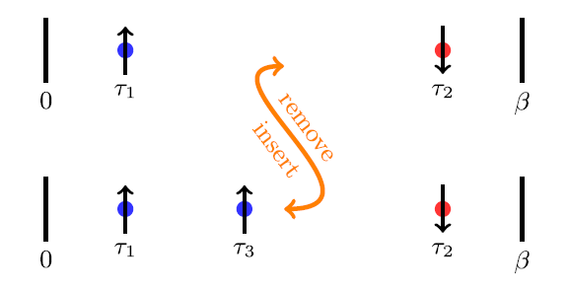
Fast update scheme
E. Gull et al., EPL, 82, 57003 (2008)
Choose update (insertion or removal)
Insertion: pick τ （0 ≦ τ＜ β） randomly and choose s = ±1
Removal: choose one of the existing vertices
Compute the ratio of the weight W(C’)/W(C)
Metropolis
Acceptance ratio:
Renew configuration if accepted
Leave old configuration if rejected
Update A⁻¹ (A⁻¹ is used to calculate W(C’)/W(C))
O(n²) operation
If configuration is unchanged, A⁻¹ is also unchanged
Go to step 1

Slide 24
Submatrix update scheme
P. K. V. V. Nukala et al., Phys. Rev. B 80, 195111 (2009).
E. Gull et al., Phys. Rev. B 83, 075122 (2011).
Starting from the initial configuration C₀, k_{max} times updates are done
Choose update (insertion or removal)
Insertion: pick τ （0 ≦ τ＜ β） randomly and choose s = ±1
Removal: choose one of the existing vertices
Compute the ratio of the weight W(C_{k}’)/W(C_{k})
Metropolis
Renew configuration if accepted C_{k+1} = C_{k}’
Leave old configuration if rejected C_{k+1} = C_{k}
Go to step 1.1
Update A⁻¹ at once after k_{max} times updates
Go to step 1 with C₀(new) = C_{kmax}
×k_{max} times
(0 ≦ k ≦ k_{max}-1)
~ 10 times speed up !

Slide 25
Extension to multi-orbital systems
E. Gorelov et al., Phys. Rev. B 80, 155132 (2009)
Action of the multi-orbital impurity problem
i, j: orbital
σ: spin
We introduce additional parameters
reduce sign problem
δ₂: small positive
number
needed to ensure ergodicity (if [G₀]_{ij} = 0)
large δ₂ → sign problem

Slide 26
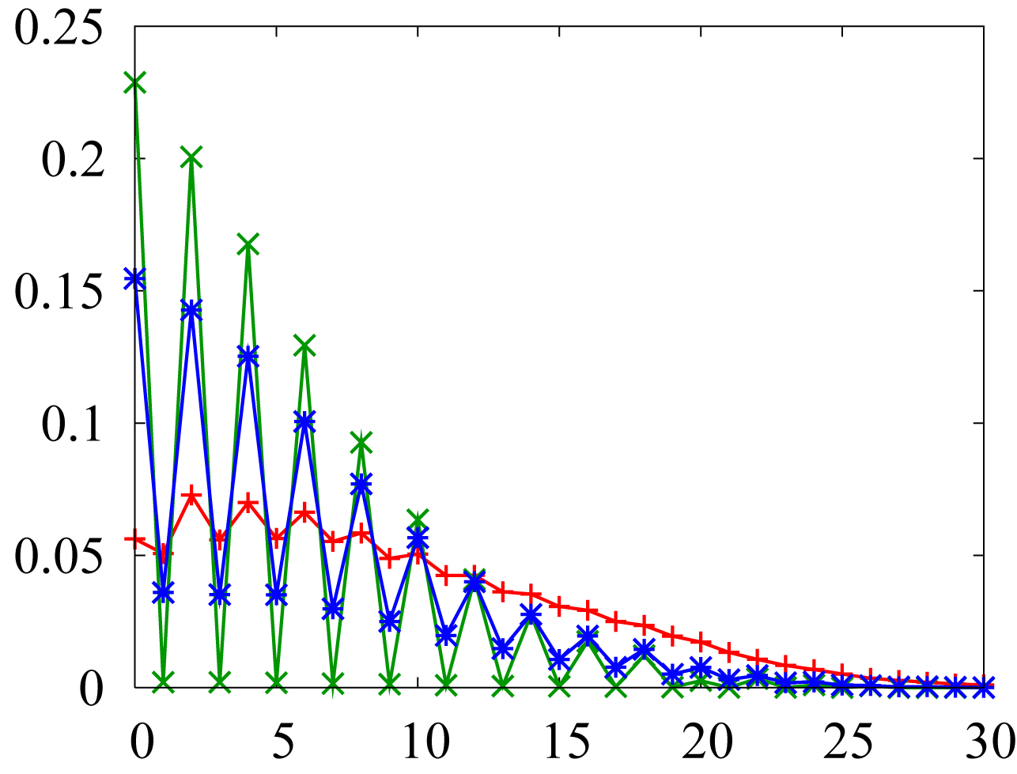
Efficient sampling of spin-flip and pair-hopping terms
2D square lattice, t = 1, t’ = 0
two-orbital Hubbard model, half-filling
W = 8t
U = 6.9 t, J= U/6, U’ = U – 2J
T = 0.05 t
single-site DMFT
no symmetry breaking
δ₂ = 0.1, norm ~ 53 %
δ₂ = 0.05, norm ~ 83 %
δ₂ = 0.01, norm ~ 99 %
Number of J vertices
In two-orbital case, weight of a configuration with odd number of J vertices is zero.
We only need to insert/remove two J vertices simultaneously
We do not need to introduce δ₂

Slide 27
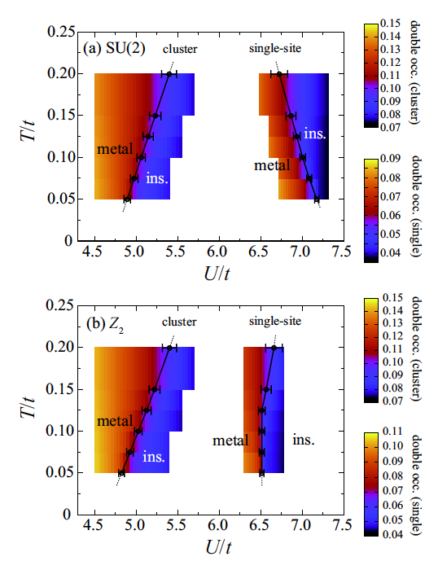
Results: 2D Hubbard model
2D square lattice, t = 1, t’=0
two-orbital Hubbard model, half-filling
W = 8t, J= U/6, U’ = U – 2J
single-site DMFT and cellular DMFT with 4 site cluster
Paramagnetic and para-orbital solution
Starting the self-consistent loop from metallic solution
Phase diagram
U_{c} (cluster) < U_{c} (single site)
Difference between the results with and without spin-flip and pair-hopping terms:
Cluster DMFT: small
Single-site DMFT: large
Single-site DMFT
Entropy(ins,SU(2)) ~ ln(3) (S=1, Sz = 1,0,-1)
Entropy(ins,Ising) ~ ln(2) (S=1, Sz=±1)
Cluster DMFT
Entropy(metal) > Entropy(ins)

Slide 28
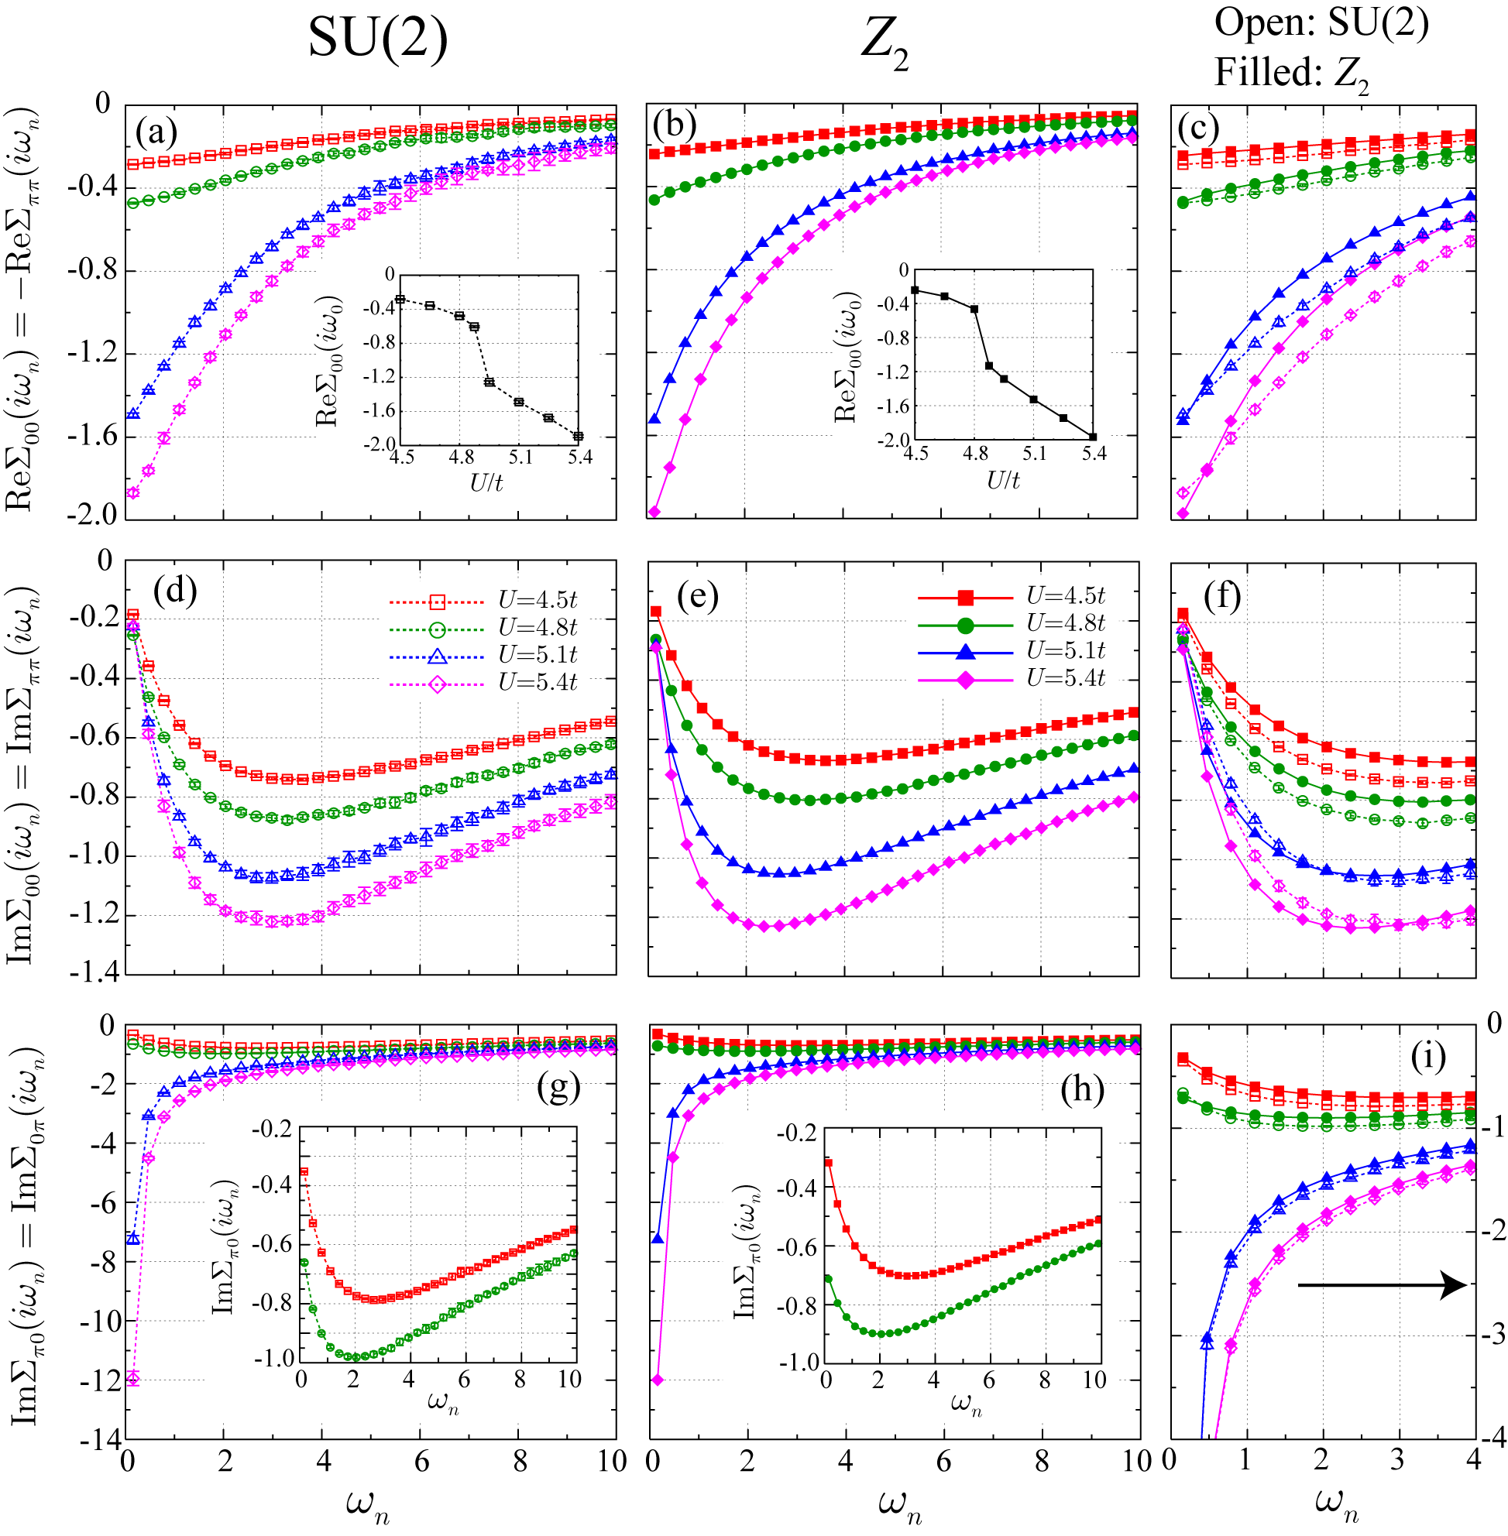
Self energy: 2D Hubbard model
(π,π)
(π,0)
(0,0)
・Divergence Im Σ_{π0}
→ Mott transition
・Abrupt change in Re Σ₀₀
at Mott transition
・difference between SU(2)
and Ising results is small

Slide 29
Conclusion
Implemented efficient update scheme (Submatrix update)
Efficient sampling of spin-flip and pair-hopping terms
Results for 2D two-orbital Hubbard model
U_{c} (cluster) < U_{c} (single site)
Effect of spin-flip and pair-hopping terms
Cluster: small ↔ single-site large
Im Σ_{π0} diverges in the insulating region
Future perspective
Analysis of the derived model for C₆₀ superconductors
Cluster DMFT study of 3 orbital model with 1/3 filling

