Slide 1
鉄系超伝導体における電子格子相互作用の 軌道揺らぎへの影響 Effect of electron-phonon interactions on orbital fluctuations in iron-based superconductors
新学術領域「コンピューティクスによる物質デザイン：複合相関と非平衡ダイナミクス」
計画班「第一原理有効模型と相関科学のフロンティア」
野村悠祐、中村和磨^{A}、有田亮太郎
東大工、九工大院^{A}
YN, K. Nakamura, and R. Arita, arXiv:1305.2995

Slide 2
Ab initio downfolding for electron-phonon coupled systems
Low-energy models for electron-phonon coupled systems:
i,j: orbital (Wannier) indices (w): Wannier gauge σ : spin index
O^{(p)}: the quantity with constraint (partially screened)
Q. How do we evaluate ?
A. Constrained random phase approximation (cRPA)
F. Aryasetiawan et al., Phys. Rev. B. 70 19514 (2004)

Slide 3
Constrained RPA
F. Aryasetiawan et al., Phys. Rev. B. 70 19514 (2004)
・Independent particle polarizability(RPA)
V
②
③
①
②
③
④
①
E_{F}
＝①＋②＋③＋④
exclude the contribution from
T↔T scattering
This screening process should be considered when we solve the low-energy effective model
④
T
Occupied (O)
V:virtual
T:target

Slide 4
Ab initio downfolding for electron-phonon coupled systems
Low-energy models for electron-phonon coupled systems:
i,j: orbital (Wannier) indices (w): Wannier gauge σ : spin index
O^{(p)}: the quantity with constraint (partially screened)
Q. How do we evaluate and ?
A. Constrained density-functional perturbation theory
YN, K. Nakamura, and R. Arita, arXiv:1305.2995
cf. Desity-functional perturbation theory (without constraint)
S. Baroni et al, Rev. Mod. Phys. 73, 515 (2001).

Slide 5
Phonon frequency and electron-phonon coupling
S. Baroni et al, Rev. Mod. Phys. 73, 515 (2001).
Phonon frequencies and electron-phonon couplings are given by
(for simplicity we consider the case where there is one atom with mass M in the unit cell)
ν：phonon mode
u : displacement of the ion
Dynamical matrix
: characteristic
length scale
where
E : electron ground-state energy
α: cartesian coordinates (x,y,z)
Key quantity
bare
Hartree + exchange correlation terms (screening)

Slide 6
Constrained density-functional perturbation theory
YN, K. Nakamura, and R. Arita, arXiv:1305.2995
In the metallic case, is given by
n,m: band indices
②
V
③
①
E_{F}
①
②
③
④
④
T
exclude the target-target processes
Occupied (O)
Partially screened quantities such as and
V:virtual
T:target

Slide 7
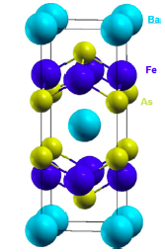
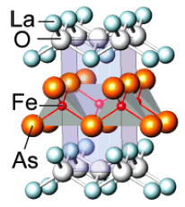
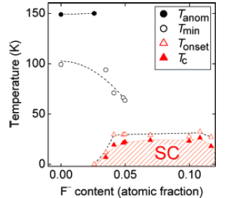
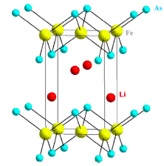
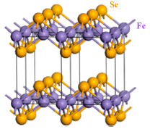
Iron-based superconductors
1111 system
122 system
G. R. Stewart, RMP 83, 1589 (2011).
I. R. Shein and A. L. Ivanovskii, Solid State Commun. 149,1860 (2009).
Y. Kamiahara et al., J. Am Chem. Soc. 130, 3296 (2008).
111 system
11 system
and more…
G. R. Stewart, RMP 83, 1589 (2011).
Z. Deng et al., Europhys. Lett. 87, 37004 (2009).
G. R. Stewart, RMP 83, 1589 (2011).
F.-C. Hsu et al., Proc. Natl. Acad. Sci. U.S.A. 105, 14262 (2008).

Slide 8
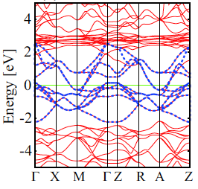
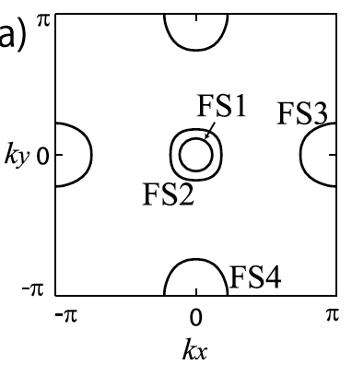
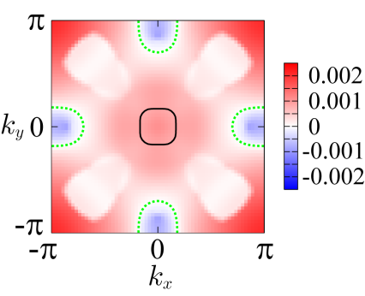
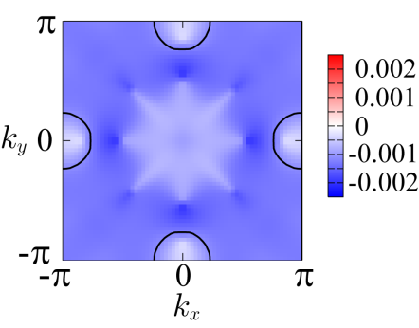
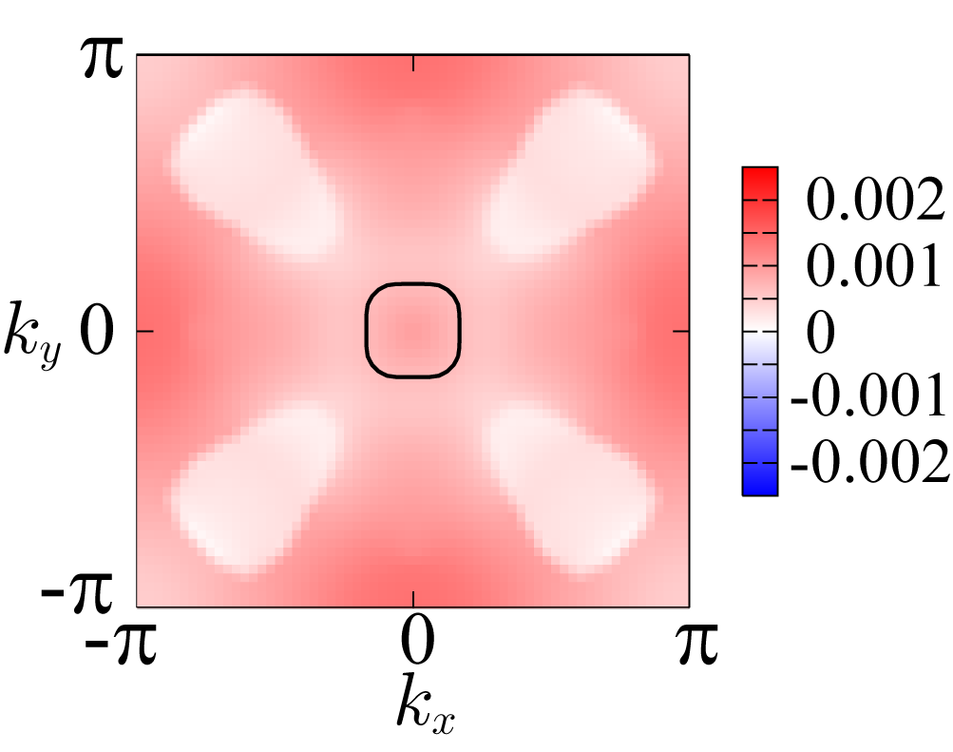
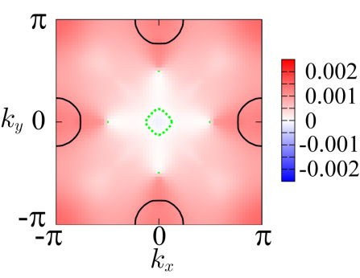
Pairing symmetry: Iron pnictide
H. Kontani and S. Onari, PRL 104, 157001 (2010).
T. Saito et al., PRB 82, 144510 (2010).
Linearized Eliashberg equation:
Band structure
Fermi surfaces
Here spin and charge fluctuations are given by
and (within RPA)
Without el-ph interactions
With el-ph interactions such that
χ^{s} > χ^{c} (spin fluctuations are dominant)
→ W < 0 (repulsive)
→ sign change in gap functions (s±-state)
χ^{c} > χ^{s} (charge fluctuations are dominant)
→ W > 0 (attractive)
→ no sign change (s++-state)
φ₃
φ₄
φ₃
φ₄

Slide 9
Role of electron-phonon interactions
Spin fluctuations (enhanced by Hubbard U ) s±-wave
Orbital fluctuations (enhanced by el-ph interactions?) s₊₊-wave
Q. Do el-ph interactions really enhance the orbital fluctuations?

Slide 10
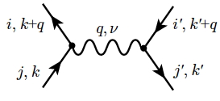
Phonon-mediated interactions
Effective on-site el-el interactions coming from the exchange of phonons:
momentum-space average -> on-site quantity
We get
cf. (Kontani & Onari)
・ J_{ph} is very small
・ not negligible compared to Coulomb repulsion U ~ 2 eV
・ these frequency dependent interactions vanish around ω_{l} ~ ω_{D}

Slide 11
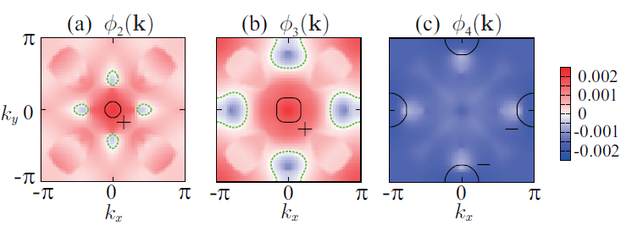
RPA analysis
・ the magnitude of J_{ph} is crucial to the enhancement of orbital fluctuations
・ spin fluctuations are dominant (since J_{ph} is small in magnitude)
Gap functions in band representation
T = 0.02 eV
n(filling) = 6.1
5-orbitals model
s±-wave state is realized

Slide 12
Conclusion
developed a method for ab initio downfolding for el-ph coupled systems
Effective parameters for LaFeAsO:
U_{ph}(0) ~ U’_{ph}(0) ~ -0.4 eV, J_{ph}(0) ~ -0.02 eV
RPA analysis -> s± (due to the smallness of J_{ph} )
YN, K. Nakamura, and R. Arita, arXiv:1305.2995

