Slide 1




First-Principles Studies of
GeTe Based Dilute Magnetic Semiconductors
「GeTeベース磁性半導体の電子状態計算と材料設計」
T. Fukushima, H. Shinya and H. Katayama-Yoshida
Graduate School of Engineering Science, Osaka University
K. Sato, Graduate School of Engineering, Osaka Univ., Japan
H. Fujii, Spring-8
P. H. Dederichs, PGI-2, Forschungszentrum Juelich, Germany

Slide 2
研究組織 「スピンエレクトロニクス材料の探索」
研究代表者
  佐藤和則（阪大基礎工 ⇒ 阪大工）
研究分担者
  小田竜樹（金沢大数理）
  野崎隆行（産総研）
連携研究者
  小倉昌子（阪大理 ⇒ ミュンヘン・ルートヴィヒ・マクシミリアン大学）
  黒田眞司（筑波大）
  鈴木義茂（阪大基礎工）
  朝日一（阪大産研）
  吉田博（阪大基礎工）
  下司雅章（阪大ナノ）
  赤井久純（阪大理 ⇒ 東大物性研）

Slide 3
Outline
Introduction
  Dilute magnetic semiconductor (DMS)
  GeTe based IV-VI type DMS
Computational method
Result
  Defect formation energy in GeTe
  Magnetic properties in TM doped GeTe
  Hole doping in (Ge,Mn)Te
Summary

Slide 4
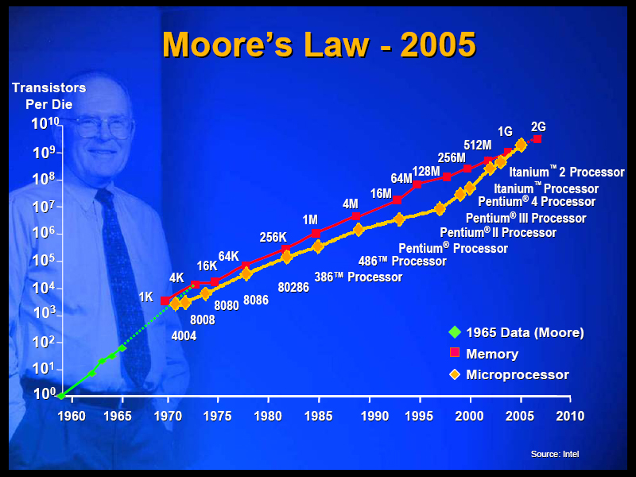
Motivation: Why spintronics?
Year | Product | Transistor number
1971 | 4004 | 2300
1993 | Pentium | 3,100,000
2006 | Core 2 Duo | 291,000,000
2008 | Core i7 | 731,000,000
2019 | the transistor scaling reaches a physical limit
Notes:
初代集積回路4004から現在のi7まで、よく成りたっている
2019ゲート長が結晶の格子定数を下回ってしまう。
リレー、真空管、トランジスタ、ICのようなパラダイムシフト

Slide 5
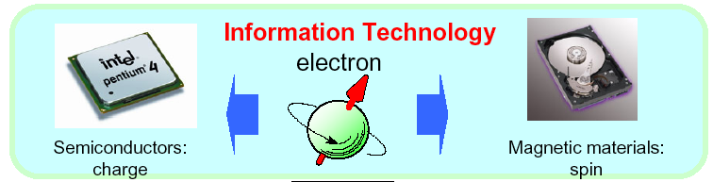
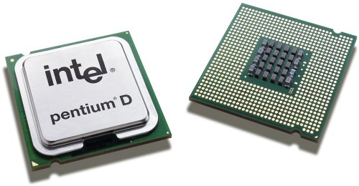

■Semiconductor Spintronics
e⁻
S
Semiconductor device
Charge control
Magnetic Memory
Spin control
Spin Control by Gating (V_{G})
Nanospintronics
■Spintransistor
■High-Tc DMS
QIT
■Quantum
Computation
■Quantum
teleportation
S
S
e⁻
e⁻
Semiconductor Nano-superstructure
■HS (THz) ■UHD(Tbit/inch²) ■Low Energy(Non-volatile)
吉田博©
Notes:
■半導体ナノスピントロニクスの説明
■現在のエレクトロニクス：電荷とスピンを独立に制御（ＩＴ技術）
■スピンと電荷を同時に制御する→スピントロニクスと量子情報処理

Slide 6
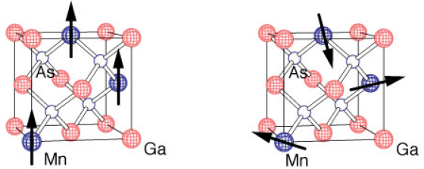
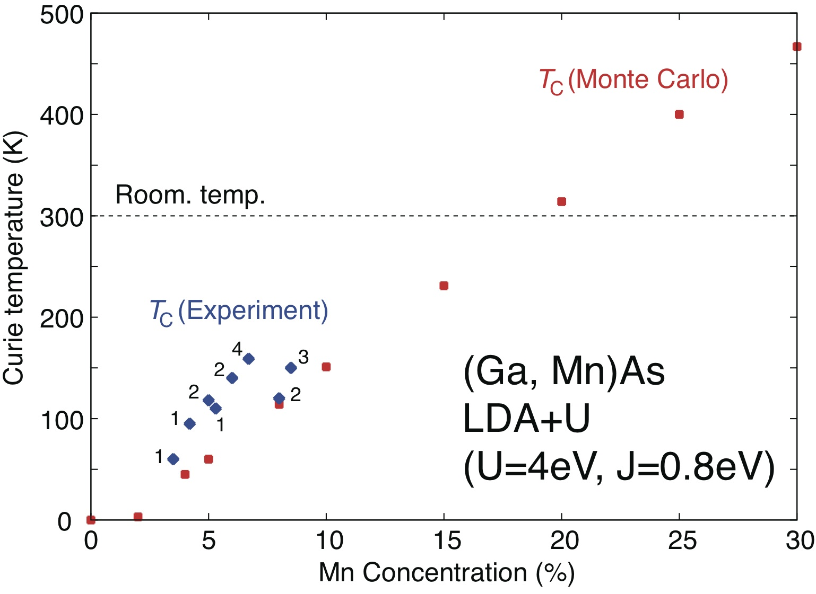
Dilute magnetic semiconductors (DMSs)
(Ga,Mn)As
Carrier induced ferromagnetism
  (In, Mn)As; T_{C} = 60 (K)
  (Ga, Mn)As; T_{C} = 190 (K)
Problem
468 K
Curie temperature < room temperature
Low solubility of transition metal
Solution
Low-temperature MBE + post-annealing
Co-doping method + post-annealing
GeTe based DMS
T. Yamamoto et al.: Jpn. J. Appl. Phys. 36 (1997)L180.
K. Sato et al.: Jpn. J. Appl. Phys. 46 (2007) L1120.
H. Fujii, et al.: Appl. Phys. Express. 4 (2011) 043003.
K. Sato, et al., Rev. Mod. Phys. 82, 1633 (2010)

Slide 7
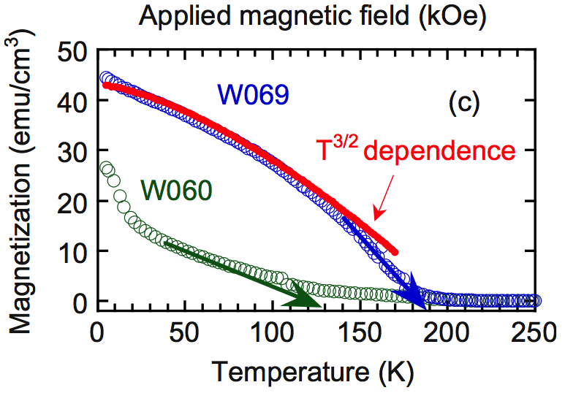
GeTe and (Ge,Mn)Te
Mn 8% doped GeTe
GeTe
Ferroelectric semiconductor
NaCl to Rhombohedral transformation at 440°C
Phase-changed material (PCM)
Ex: (Ge,Mn)Te
No miscibility gap below 50% of Mn
Alloying over wide range of concentration
Y. Fukuma et al., Appl. Phys. Lett. 93 (2008) 252502.
W. D. Johnston et al., J. Inorg. Nucl.Chem. 19 (1961) 229.

Slide 8

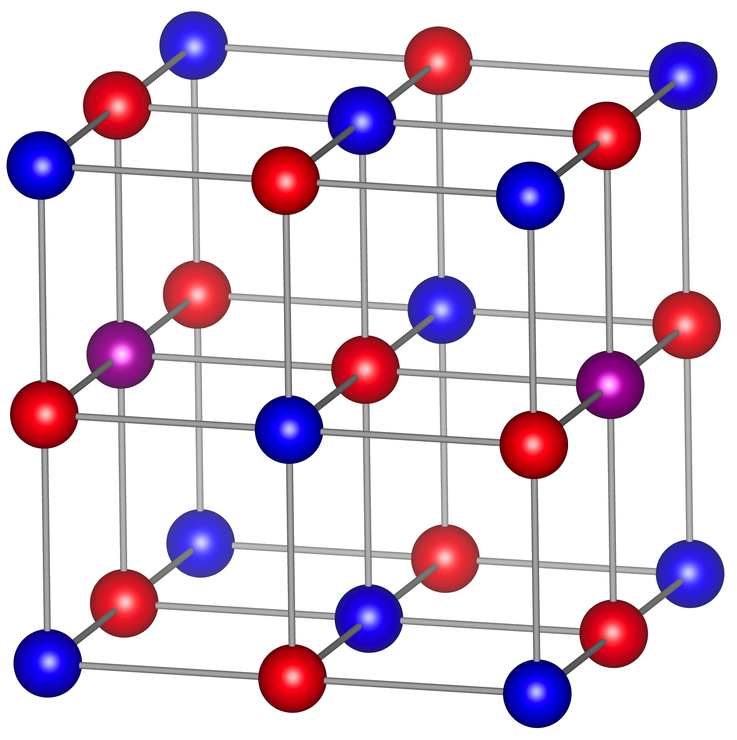
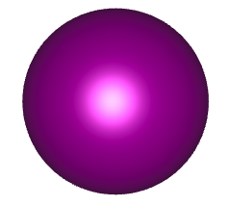
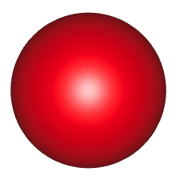
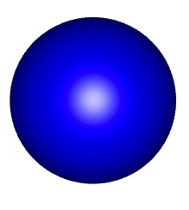
Computational method
H. Akai: http://sham.phys.sci.osaka-u.ac.jp/kkr/
https://www.vasp.at
Rocksalt structure
Local density approximation (LDA)
Scalar relativistic approximation
Coherent potential approximation (CPA)
lmax=2, energy mesh=60
TM
Ge
Te

Slide 9
Band structure of GeTe compound
Top of valence band
Ge-4s Te-5p antibonding state
Ge
GeTe
Te
4p
Ge-4p
4p
E_{F}
Te-5p
s-p
interaction
5p
5p
4s
Ge-4s
4s
5s
5s
Te-5s
Hole carriers ➔ stabilization of the crystal
p-type conductivity

Slide 10
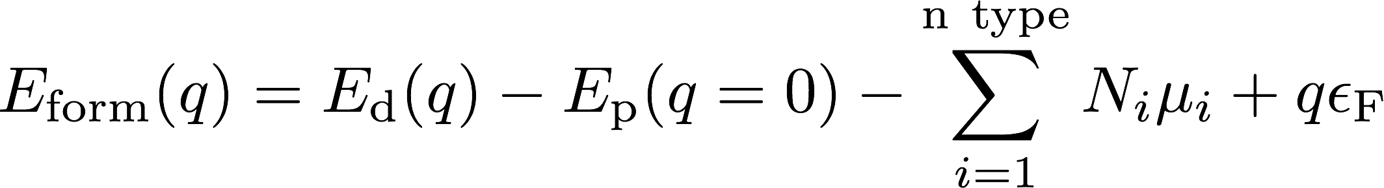
Native defects and TM impurities in GeTe
Formation energy (FE)
V_{Ge}: Ge vacancy
V_{Te}: Te vacancy
Mn_{s}: substitutional Mn
Cr_{s}: substitutional Cr
High solubility
for Ge vacancy and
TM impurities
Notes:
E_{¥rm form}(q)=E_{¥rm d}(q)-E_{¥rm p}(q=0)-¥sum_{i=1}^{¥rm n¥ type}N_{i}¥mu_{i}+q¥epsilon_{¥rm F}

Slide 11
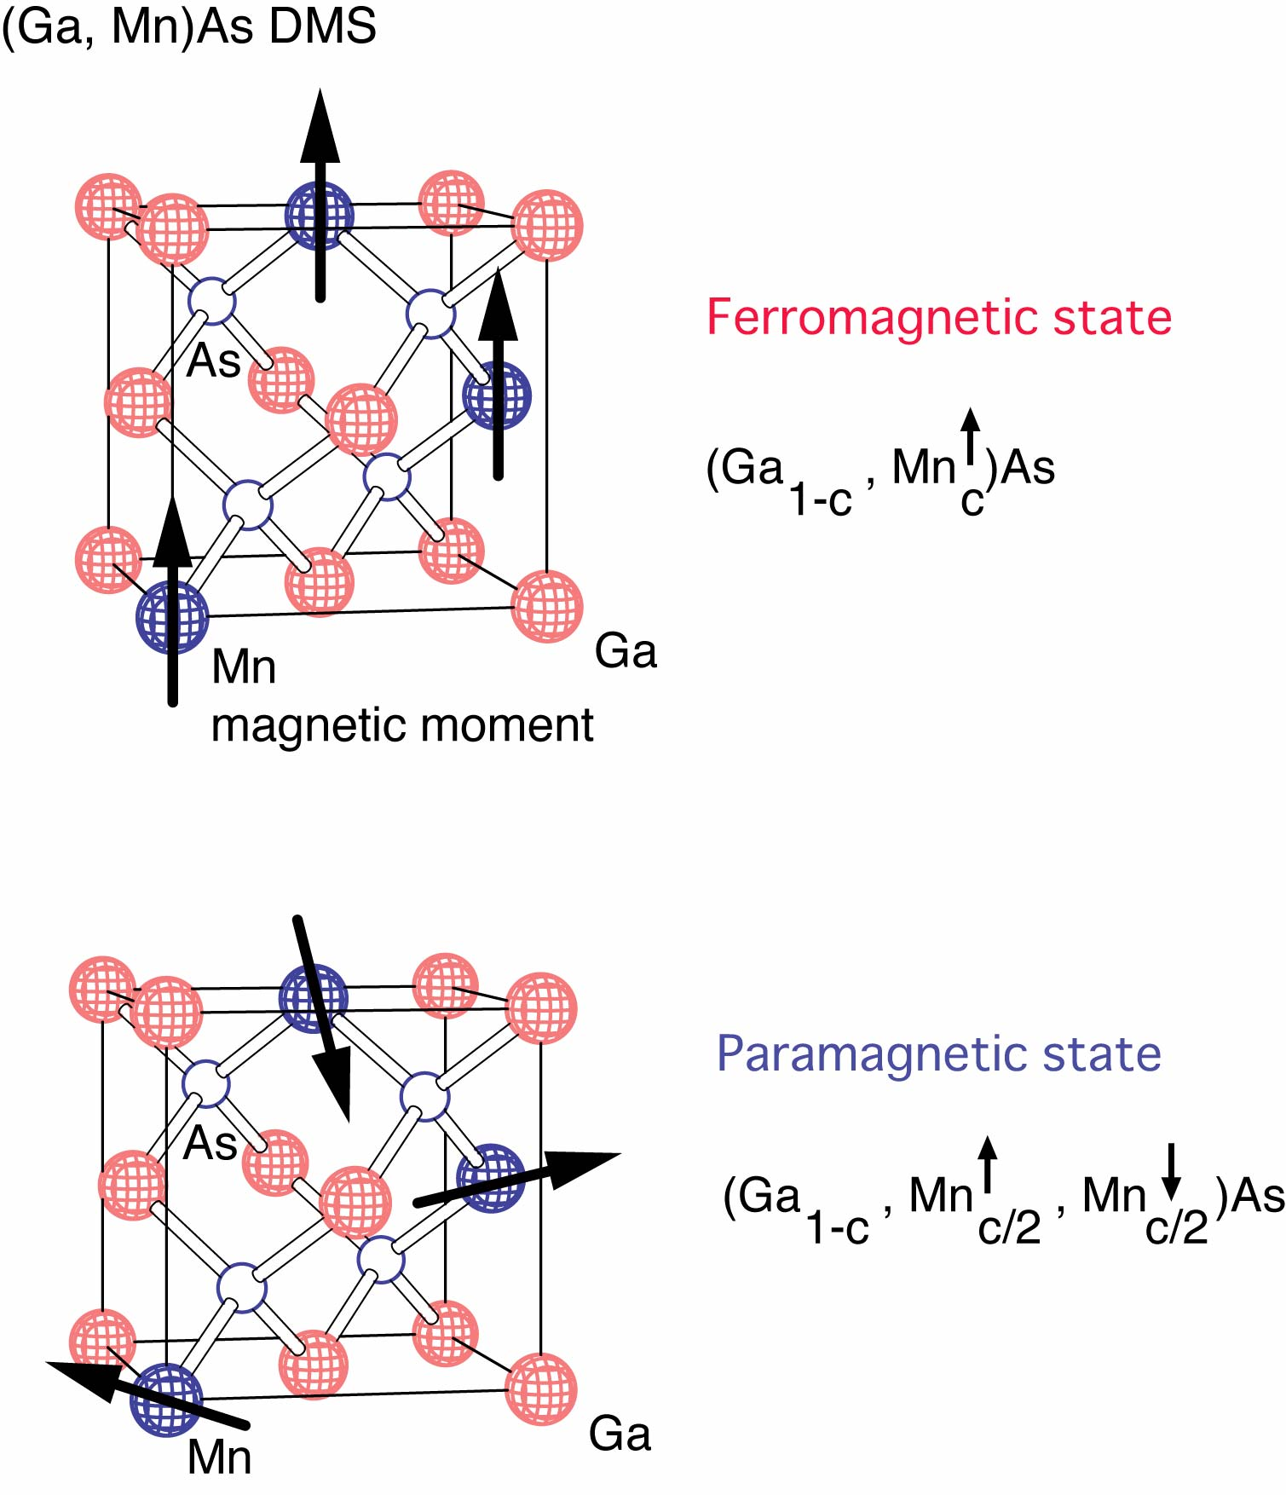
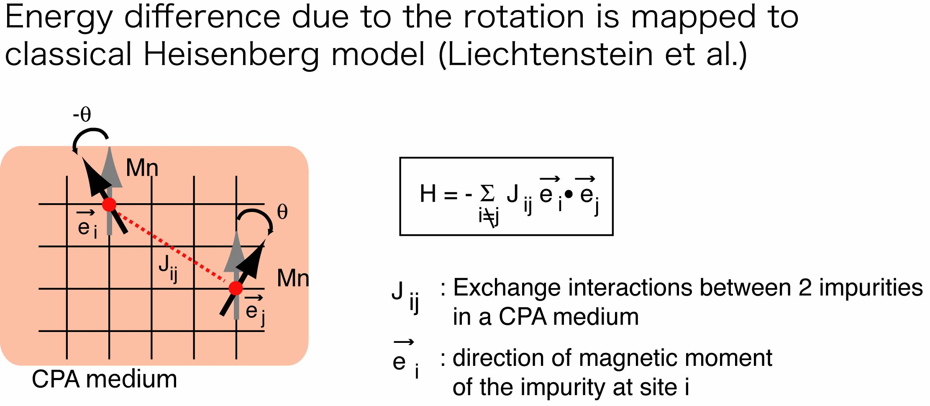
Calculation of magnetic properties of DMS by KKR-Green’s function method
K. Sato et al., RMP 82 (2010) 1633., L. Begqvist et al., PRL 93 (2004) 137202
K. Sato et al., PRB 70 (2004) 201202
Exchange interactions by Liechtenstein’s formula
Energy difference due to the rotation is mapped to
Classical Heisenberg model (Liechtenstein et al.)
:exchange interaction in a CPA medium
:direction of magnetic moment
CPA medium
Statistical method for T_{C}
  Mean field approximation (MFA)
  Random phase approximation (RPA)
  Monte Carlo simulation (MCS)
KKR-CPA-LDA
→ MACHIKANEYAMA2002
(H. Akai)
Notes:
This viewgraph summarizes our method. DMS is a disordered system, for example, in GaMnAs, Ga atoms are replaced by Mn randomly as shown here. In ferromagnetic states, magnetic moments of Mn are parallel, but in paramagnetic states, direction of the Mn moments are also random. This substitutional and magnetic disorder is treated in the framework of coherent potential approximation. I use the KKR-CPA-LDA package developed by Akai. In the mean field approximation, total energy difference between FM and DLM states gives estimation of Tc. For more accurate Tc calculations, we calculate effective exchange interactions between magnetic impurities in DMS by using the Liechtenstein’s formula. In the Liechtenstein’s approach, first we put two Mn in the CPA medium, then we calculate total energy change due to the rotation of magnetic moments at site i and j, and map the energy change on the classical Heisenberg model to estimate exchange constants Jij. Once, the exchange interactions Jij are calculated, we can use statistical method such as the mean field approximation, random phase approximation and the Monte Carlo simulation to calculated Tc. This is our framework to calculate magnetic properties of DMS.

Slide 12
DOSs of TM (10%) doped GeTe

Slide 13
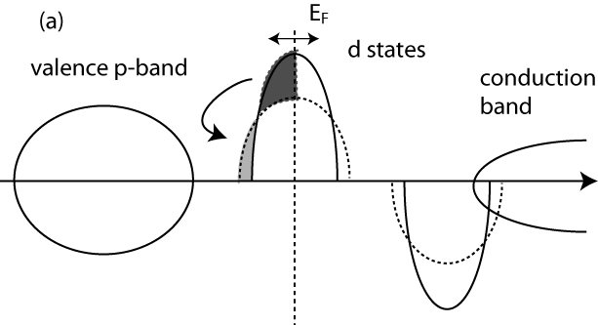
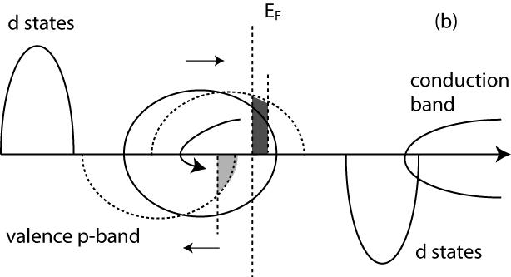


Double exchange vs. p-d exchange interaction
K. Sato, et al., Rev. Mod. Phys. 82, 1633 (2010)
Double exchange interaction
p-d exchange interaction
Wave functions of impurity band in band gap
decay exponentially
Ferromagnetism is stabilized by
polarization of valence state
Short ranged interaction
Long ranged interaction

Slide 14
Exchange coupling constants in TM doped GeTe
Ferro
Antiferro

Slide 15
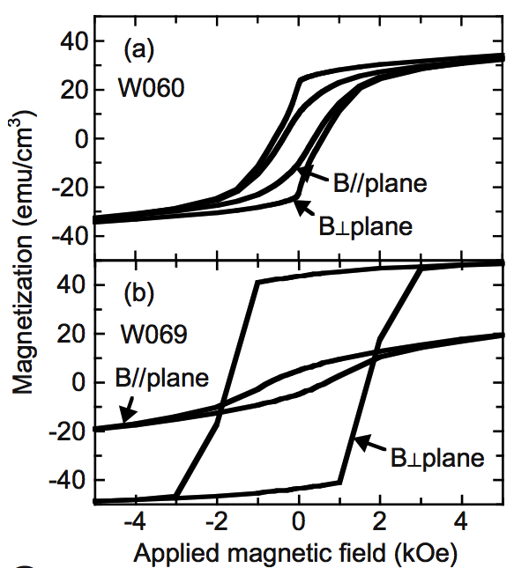
Discrepancy in (Ge,Mn)Te: Ferro or Antiferro?
Experiments
Our calculations
Y. Fukuma et al., Appl. Phys. Lett. 89 (2006) 152506.

Slide 16
Hole doping in (Ge,Mn)Te by Ga vacancy
By hole doping ferromagnetic state is stabilized.
Half-metallic DOS
Mn²⁺(d⁵) + hole
  Localized d-states
  Holes in valence bands
V_{Ga}: 10%
p-d exchange interaction stabilizes ferromagnetic state

Slide 17
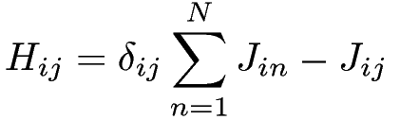

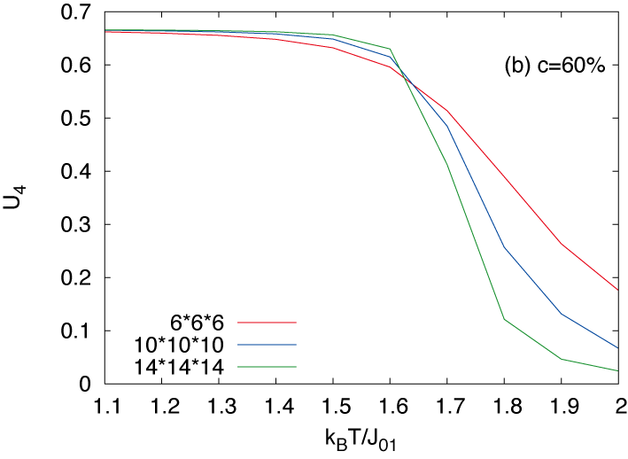
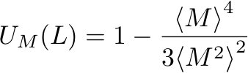
Calculation of T_{C} by RPA and MCS
Random phase approximation (RPA)
Monte Carlo simulation (MCS)
2D square Heisenberg model
4th order cumulant
(finite size scaling)
： magnetization
: lattice size

Slide 18
T_{C} of (Ge,Cr)Te and (Ge,Mn)Te + V_{Ge}
(Ge,Cr)Te
(Ge,Mn)Te + V_{Ge}:20%

Slide 19
Conclusion
Electronic structure and magnetic properties of GeTe based DMS are investigated by Akai-KKR code and VASP code.
High solubilities of transition metals can be expected.
Ferromagnetism is stable for V, Cr, and Fe doped GeTe.
V_{ge} stabilizes ferromagnetism in (Ge,Mn)Te.
Curie temperatures of (Ge,Cr)Te and (Ge,Mn,V_{Ge})Te reach room temperature.

Slide 20
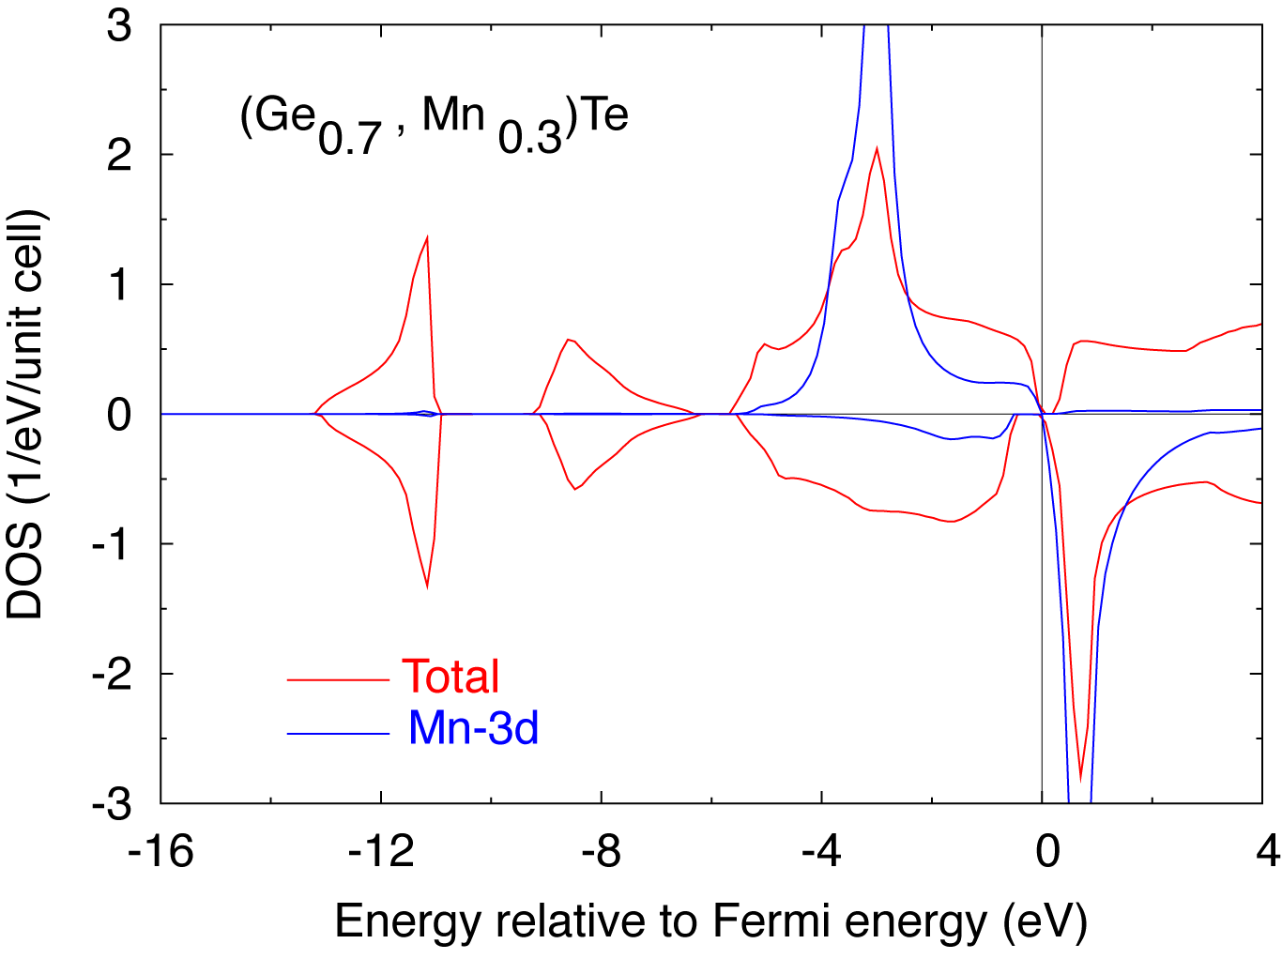
Electronic structure of GeMnTe
x=0.2 (EPMA)
Mn 3p-3d resonant photoemission
Partial DOS of Mn-3d
Energy res. = 150 meV
Main peak at 3.8 eV
Broad feature at 8 and 1 eV
Similar to GaMnAs
LDA: Mn-3d at ~3 eV
Senba et al., J. Electron Spectros.
Relat. Phenom. 144-147 (2005) 629
Notes:
Based on this general discussion on the ferromagnetism in DMS, I will discuss the electronic structure and ferromagnetism in IV-VI DMS systems. Concerning to the electronic structure of Mn-doped GeTe, Senba et al. measured partial density of Mn-3d states in GeMnTe by using resonant photoemission spectroscopy. This is the observed spectrum. As shown here, the main peak of Mn-3d states appears at 3.8 eV below the top of the valence band. This upper panel shows calculated DOS os GeMnTe by using the KKR-CPA-LDA. Red line shows total DOS and blue line shows partial DOS of Mn-3d states. The Mn-3d states are predicted approximately at -3 eV and this corresponds well to the experimental result. Since the Mn states are localized and located at the bottom of the valence bands, If holes are doped ferromagnetic state is stabilized by the p-d exchange mechanism.

